Slide 1
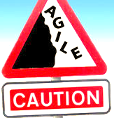
Agile Pitfalls
- Prof K G Krishna

Slide 2



Text/Reference Books
T1
T2
Compliments of IBM
➔ As this field is evolutionary, the student is advised to stay tuned to the current and emerging practices by referring to their own organization’s documentation as well as Net sources

Slide 3
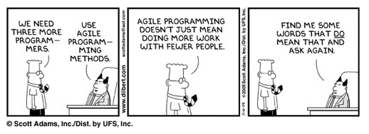
Topics
Agile Myths & Pitfalls
Common Mistakes/Myths in Agile
Predictive Planning vs. Adaptive Planning
CMMI vs. Agile
Distributed Agile

Slide 4
Common mistakes/misunderstandings
✗ Agile Process is Adoption/Adaptation of ‘Waterfall-inspired’ Predictable Iterative and Incremental Process
“…We have adopted iterative method for two months and finished use case analysis and plan and schedule of what we’ll be doing in each iteration. After review and approval of final requirements set and iteration schedule, we’ll start programming…”
✗ Scrum Masters/Managers Direct the Team
Scrum Master is a only a Facilitator of the Process, removes roadblocks
✗ No Daily-update of Sprint-backlog by Members
✗ New Work added to Iteration or Individual
Stability is required at least once an Iteration starts
✗ Owner is Not Involved or take Decisions--too Many ‘cooks’ involved
Scrum is Customer-driven and Product Owner represents Customer’s Requirements and hence defines/prioritizes Product-backlog
✗ Design/Diagramming is followed, Documentation is bad
Scrum is pragmatic in its choice of tools—simple and value-adding (“don’t use sword when nail is enough”)
✗ Too many Meetings, too often
Short (<15mins) Daily Meeting to sync-up on Issues (not problem-solving which happens in constant communication/collaboration among all team members)
✗ Iteration is Not complete and without Integration testing
Each Iteration is Fully Done—coded, unit-tested, integration-tested and documented; can be a release to customers (though after couple of iterations)

Slide 5
Common mistakes/misunderstandings (contd.,)
✗ Applying a subset of Practices that do not complement/compensate each other
e.g., Collective Code Ownership is not feasible with Testing, Continuous Integration and Coding Standards; minimal requirements documentation is not feasible without onsite customer; frequent refactoring doesn’t work without testing, etc.
✗ Not Writing Unit Tests First
Writing the tests first influences how one conceives, clarifies, and simplifies the design; test-first has an interesting psychological quality of satisfaction: I write the test, and then I make it succeed; there is a feeling of accomplishment that sustains the practice
✗ No Customer-owned Tests (UAT)
✗ Minimal Refactoring
The XP avoidance of design thought before programming is meant to be compensated by a relatively large refactoring effort, such as 25% of total effort applied to refactoring
✗ Many Fine-grained Tasks (Story cards)
Most task cards should be in the one or two-day range of effort. Most in the “few hours” range creates unnecessary information management.
✗ Pairing with One Partner Too Long
XP pairing changes frequently, often in two days or less. Variation also helps spread the learning.
✗ Customer or manager is tracker
Programmers will feel awkward reporting slow progress.

Slide 6
Common mistakes/misunderstandings (contd.,)
✗ Not integrating the QA Team
Many organizations have a separate Quality Assurance team, used to having a completed system “thrown over the wall” to them.
✗ Post development design is wrong
XP isn't anti-documentation, but prefers programming if that's sufficient to succeed. XP can support the creation of design documentation to reflect the existing code base, once the program is complete
✗ In Pair programming, not willing to learn or explain
For successful pair programming, an attitude of openness to learning and of explaining yourself is required.
✗ Iterations are NOT Time-boxed
It is a misunderstanding to let the iteration length expand when it appears the goals can't be met within the original time frame--rather, the preferred strategy is usually to remove or simplify goals for the iteration and analyze why the estimates were off the mark
✗ Each iteration ends in a production release
The baselined software produced at the end of an iteration is an internal release rather than shippable code. It represents a subset of the final production release, which may only be ready after a dozen or more short iterations
✗ Predictive Planning
It is a misunderstanding to create, at the start of the project, a believable plan laying out exactly how many iterations there will be for a long project, their lengths, and what will occur in each. This is contrasted with the agile approach: adaptive planning.

Slide 7
Agile Myths in a Nutshell…
Should customize the choice of practices without having first applied them all.
“Doing XP” means to avoid the waterfall model and develop iteratively, or just to avoid documentation, or just to write some unit tests.
Customers are not involved in the Planning Game, creating acceptance tests, or reviewing the iteration results.
Create a plan laying out how many iterations there will be for the project, their lengths, and what will occur in each (Predictive Planning)

Slide 8
Agile Pitfalls/Challenges
Culture Change: Top-down, big-bang culture change, adaptation, and institutionalization; traditional management methods clash with Agile concepts and practices
Fixed-price Contracting? Not amenable to traditional fixed-price contracts for large agile projects which are complex
Resistance to Drop Established QA Practices: Not willing to integrate or totally dissolve structures related to QA and Testing functions
Inadequate Management/Development Tools
Fuzzy Interface with Architecture, Quality, Security and Usability functions
Lack of Planning: Non-standardization of Release and Iteration Planning
Lack of Trust/Teamwork: Tendency to Micromanage, Organizational Politics, and Conflicts between Developers and Project Managers
Inadequate QA: Inconsistent use of Agile testing, Usability, Security and other QA Practices; Inadequate testing to meet iteration time-box constraints
Lack of Expertise: Inadequate Skills and Experience (SME and Coaches)
Multisite/Multiteams: Working on complex R&D/Large Projects across Locations

Slide 9
Planning (Waterfall vs. Iterative vs. Agile) ➔➔

Slide 10
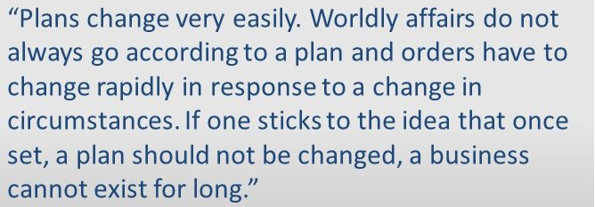
Predictive Planning vs. Adaptive Planning (Agile)
Predictive Planning (flavor of ‘waterfall’)
Planning for few Large Milestones
Determining in advance Number of Iterations
Plan in Detail All The Iterations
Adaptive Planning (flavor of ‘agile’)
Though Milestones can be fixed, but the Path towards Milestones is flexible
Milestones can themselves change later in the best interests of Project
Plan in Detail for the Just Next Iteration
Taiichi Ono
Father of Lean (Toyota Production System)

Slide 11
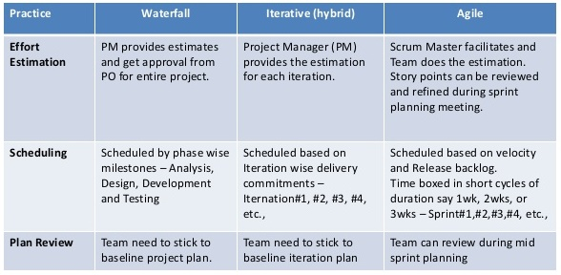
Planning: Waterfall vs. Iterative (Predictive Planning) vs. Agile (Adaptive Planning)

Slide 12
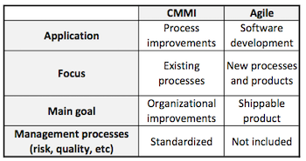
The ‘Big’ Cultural Differences between CMMI and Agile

Slide 13
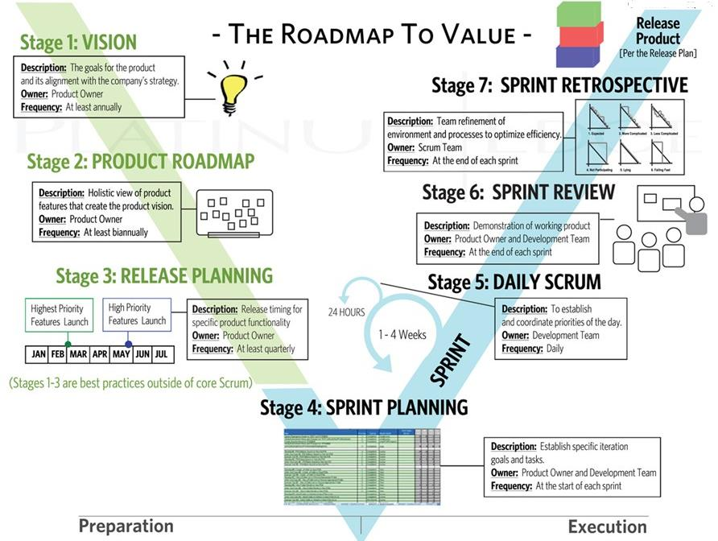
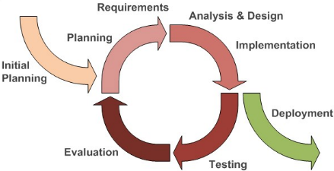
Agile is NOT an Iterative Adaptation of Waterfall (V-Process) Model!
≠
Source: (T2)

Slide 14
Distributed Agile (Multisite/Multiteam) ➔➔

Slide 15
Multisite / Multiteam Planning
For projects that will be composed of multiple teams, spread across different locations, consider doing the early iterations at one location, in one common project room, with a small group ideally composed of one or two skilled representatives from each of the subteams.
During these iterations, there is an emphasis on requirements analysis and development to discover and build the core architecture of the system—the foundation.
Major components, and their collaborations and interfaces are ideally clarified through early programming and testing rather than just speculative design; the early project benefits from the close communication, collaboration, common vision, and technical strength of the initial group.
Once the core is built, the representatives return to their respective locations, form larger teams, and the remaining work is done in parallel with multiple subteams.
Each representative has developed a clearer picture of the vision and architecture, and can better convey and maintain that for the remainder of the project. Further, each acts as a liaison to the other teams. Also, after having spent some close time with the other subteam leaders, there is improved communication between the subteams.

Slide 16
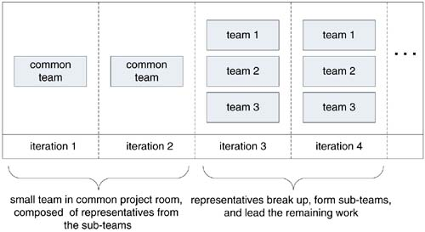
Multiteam Development
Have all components, across all subteams or sites, integrated and tested together to conclude the release of a common iteration (to be relaxed in certain projects involving R&D, e.g. development of 5G protocol stack)

Slide 17
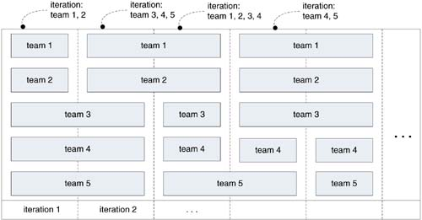
Subteam Iterations (for R&D Projects)
Ideal for Multisite research-oriented project, the preferred guideline is that all teams work together towards a common goal and integrate on a common iteration end date

Slide 18
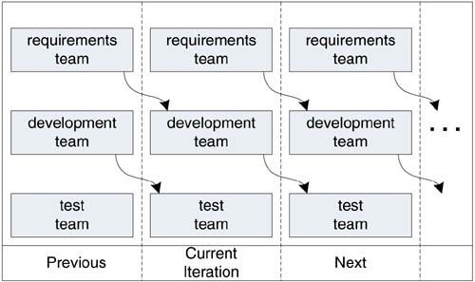
Pipelining Iterations (for large projects)
More appropriate for larger projects, those with offsite requirements donors, or those with long, complex testing that must be performed by a separate expert team (e.g. complex testing which includes labour-intensive manual testing, security testing and memory-leak stress testing, etc. where the system needs to run for many hours or days to discover defects)

Slide 19
Summary: Agile Myths – Debunked / Major Challenges
Agile is NOT an adoption of Spiral and other IID methods of ‘Waterfalll era’
There IS just enough Planning for meeting major milestones, but the path towards milestones can involve multiple (and unpredictable number of) iterations
Agile does NOT avoid Design, but evolves Design with each Iteration
Agile (Scrum, in particular) DOES support minimum (and agile) Process vs. (rigid and monolithic) process in Waterfall model
Not EVERY Iteration should lead to Production Release
Handling Fixed-price Contracts is a Challenge in Agile—but NOT impractical
Culture change is the BIG Transformation effort required before going for Agile
Multisite/Multiteam Projects too can be handled using Agile using appropriately planned and coordinated Iterations across locations

Slide 20
Thank You
© Copyrights of original Authors are duly acknowledged
™ ® All Trademarks, Registered Trademarks referred in this document are the property of their respective owners

